Slide 1
Innovative test solution provider

Slide 2
Contents
Corporate Overview
Organization Chart
Core Value
Products
Corporate Vision

Slide 3
Corporate Overview
Company name
CEO
Establishment date
Location
Capitalization
: INNOVO SOLUTION. CO., LTD.
: Young-Jae Chung
: 13 Feb. 2007
: Head office & Factory
333-9, Sangdeawon1-dong,
Jung-won-Gu Seongnam-Si, Gyeonggido,
462- 807 ,Korea
: ₩ 1,900,000,000
Page 3

Slide 4
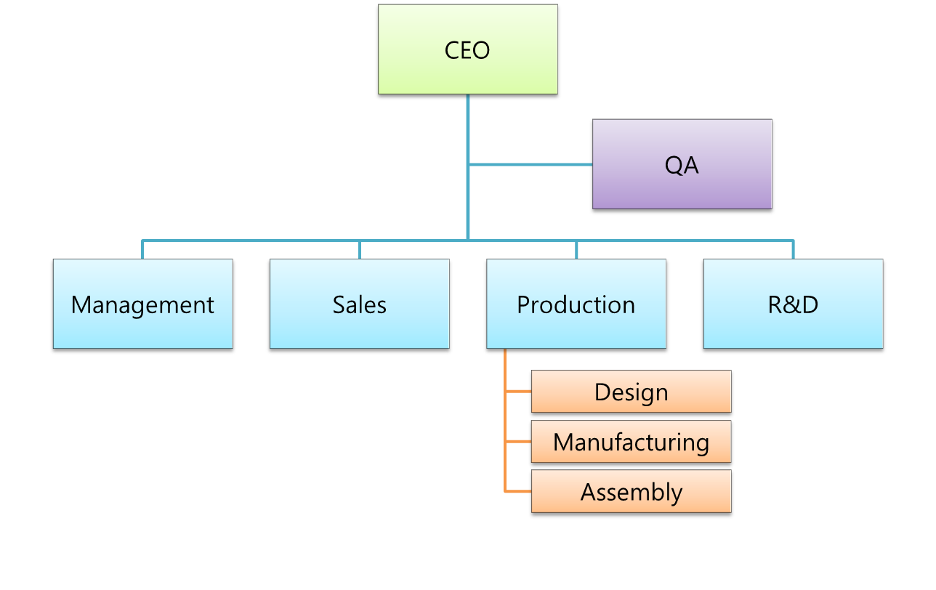
Organization Chart
Page 4

Slide 5
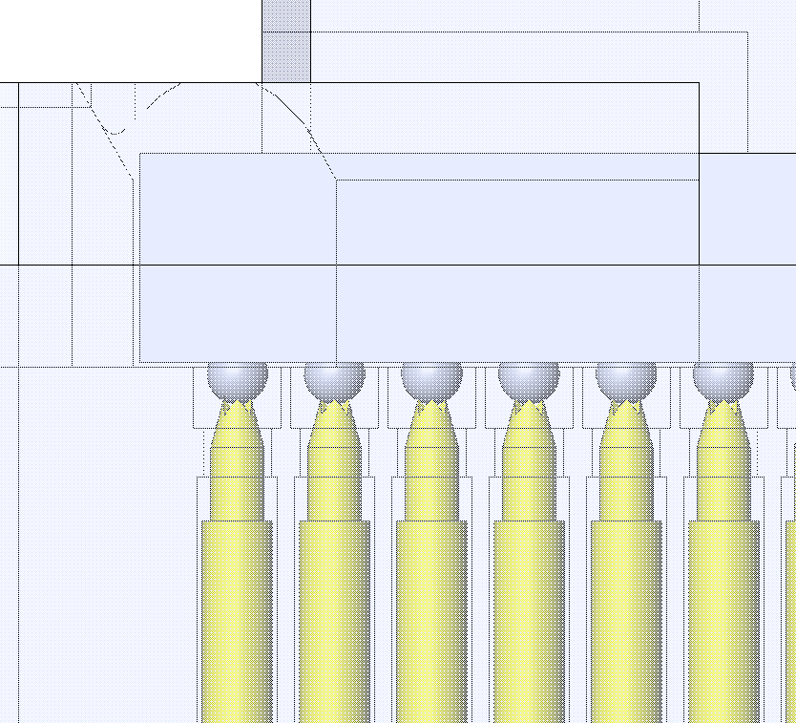
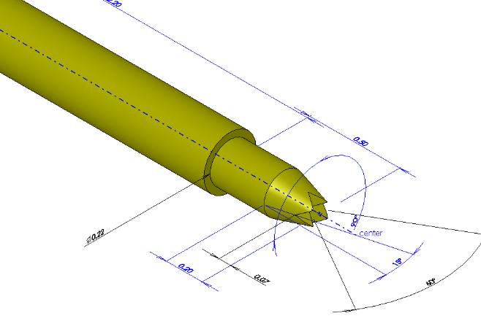
※ Core Value – Integrated test solution
- Integrated test solution (from probe pin to test socket)
  When started to design a Socket and Probe pin, our design team uses 3D design simulation system to analyze various aspects.
  Which can detect any field defect or problem.
Page 5

Slide 6
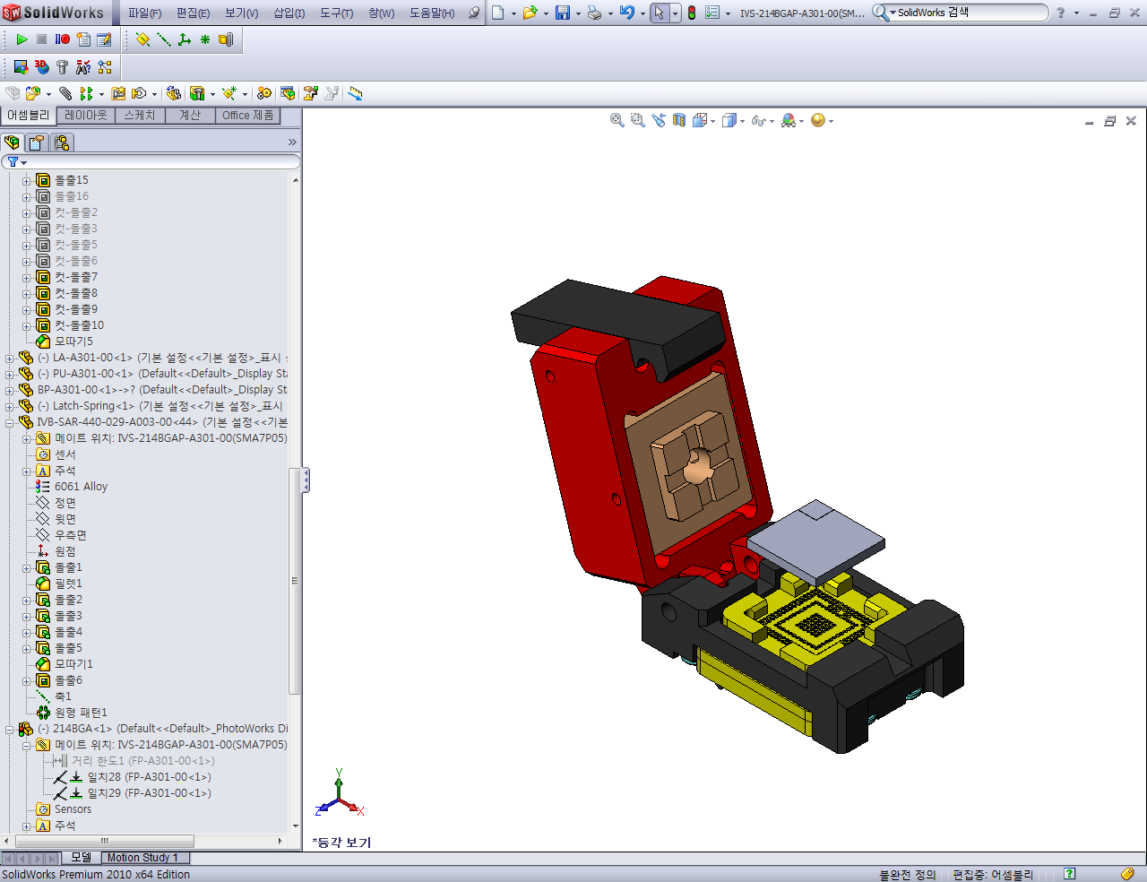
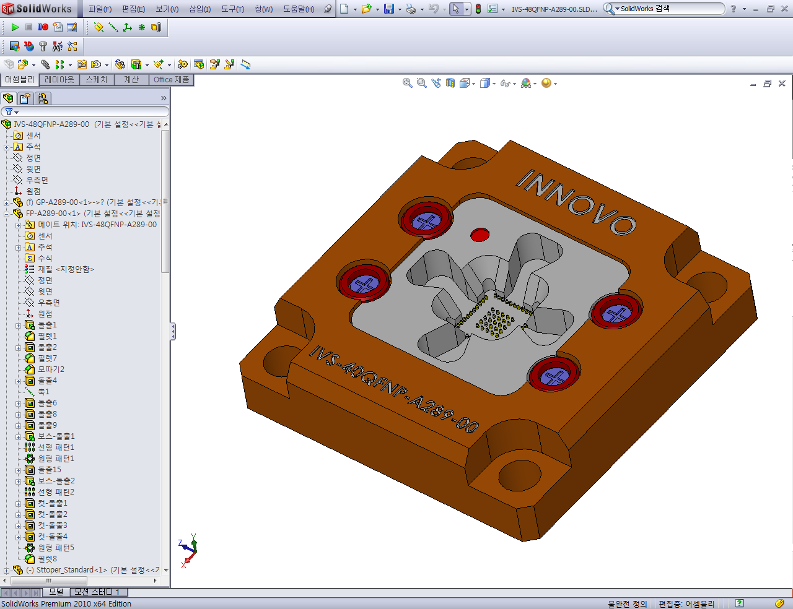
※ Core Value – Size optimization
- Size optimization
  → INNOVO provides the customized and optimized test socket depending on the size of IC.
  → This is able to give the best test condition.
Page 6

Slide 7
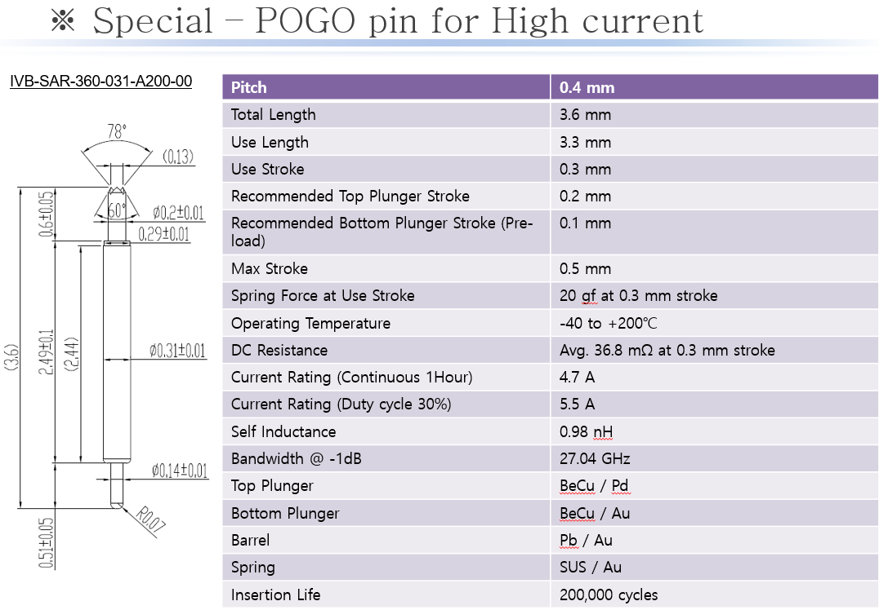
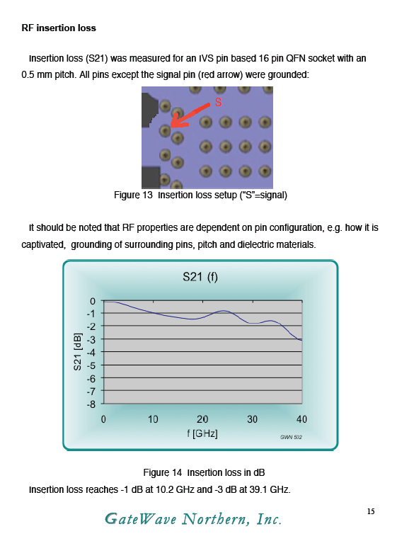
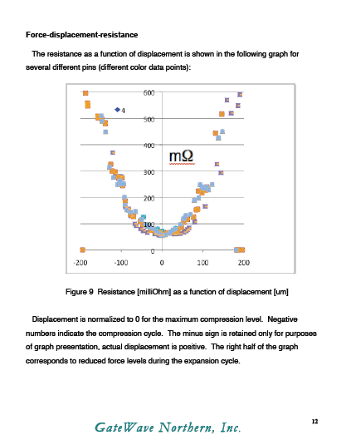
※ Core Value – High current test solution
- High current test solution
  → INNOVO has great experience about the field of power IC & PMIC.
  → Providing the stable test result, INNOVO’s socket conduct safely under the high current condition.
Page 7

Slide 8
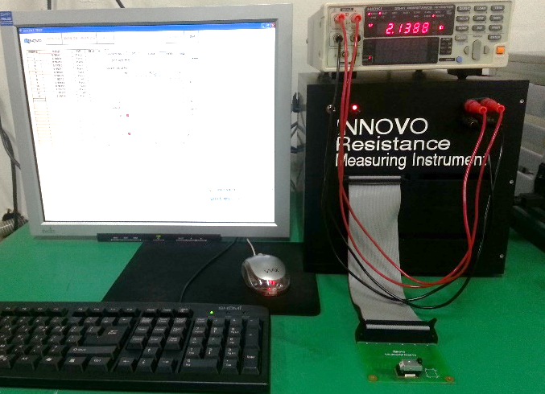
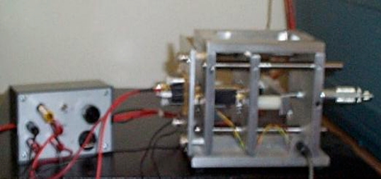
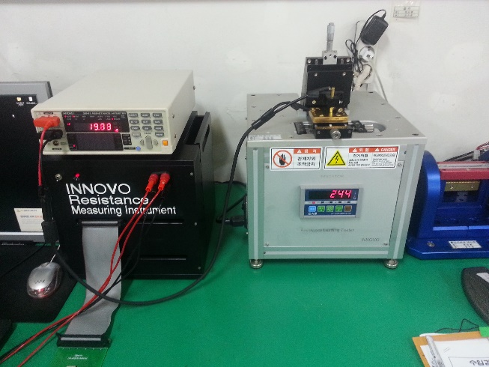
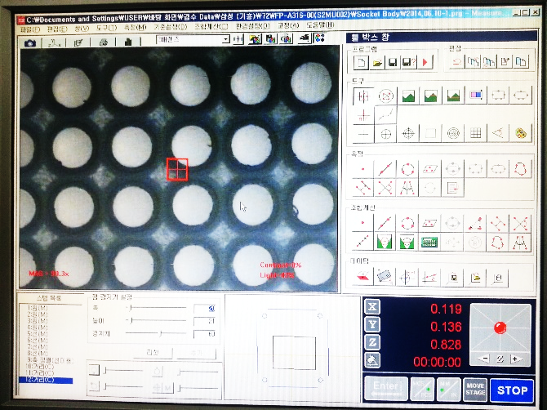
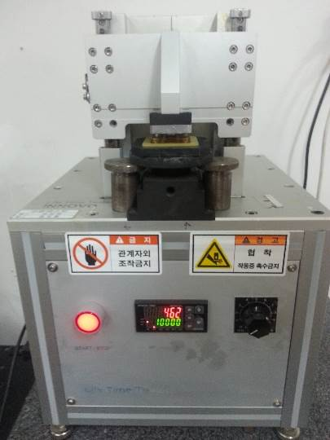
※ Core Value – Customized test machine
- Customized test machine
  → INNOVO has developed the customized test machine which is related with customer needs and condition.
  → Having a quality control system, INNOVO provides a highly reliable product to customer.
Page 8

Slide 9
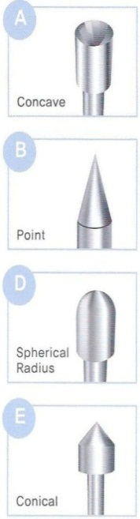
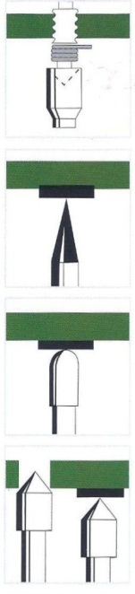
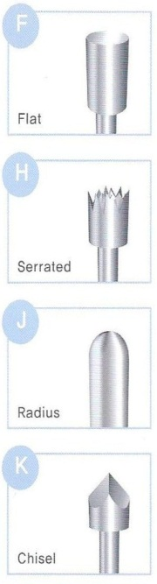
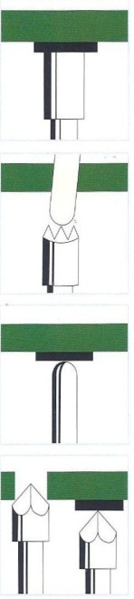
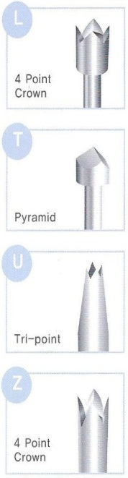
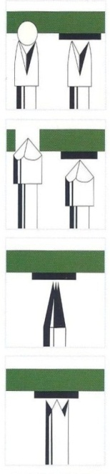
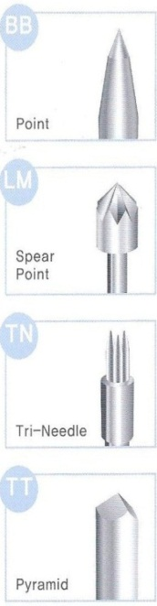
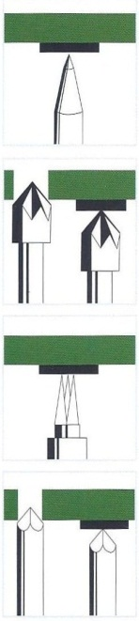
※ Products – Probe pin
General POGO pin
Special POGO pin (for High current & Low pitch)
Customized probe pin
Tip style & Application
Page 9

Slide 10
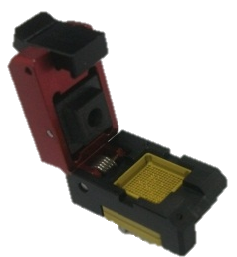
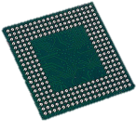
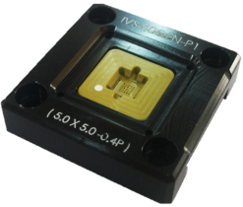
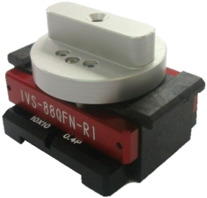
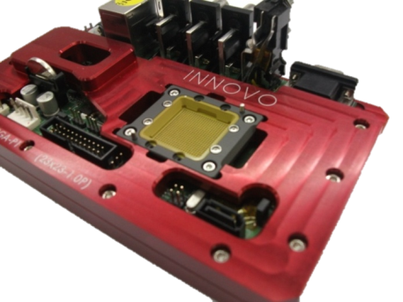
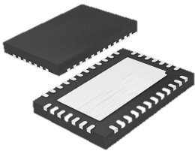
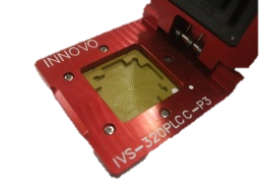
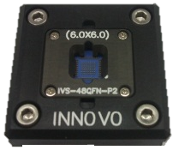
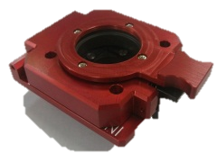
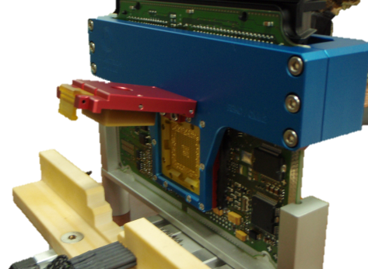
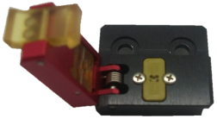
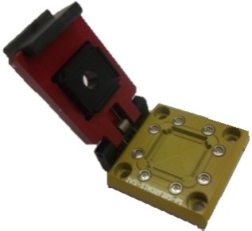
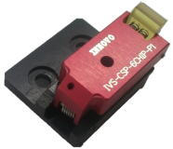
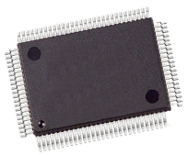

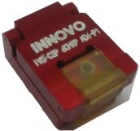
※ Products - Test socket & JIG Application
BGA
PCB test JIG
QFN
PLCC
WLCSP
QFP
ECU test JIG
Page 10

Slide 11
Corporate Vision
Customer
`
Quality
Price
Performance
Delivery
Novelty
Intelligence
Creativity
Innovation
Productivity
Originality
Novelty
Creativity
Productivity
Stability
Page 12

Slide 12











Major Accounts
Page 17

Slide 13
Thank you.
InnovoSolution Co., Ltd.
12, Galmachi-ro 203beon-gil, Jungwon-gu, Seongnam-si, Gyeonggi-do, Republic of Korea
Indy (SB) Chung .
Director .
Phone: +82-10-2850-9025
Fax: +82-31-735-6145 .

